Slide 1

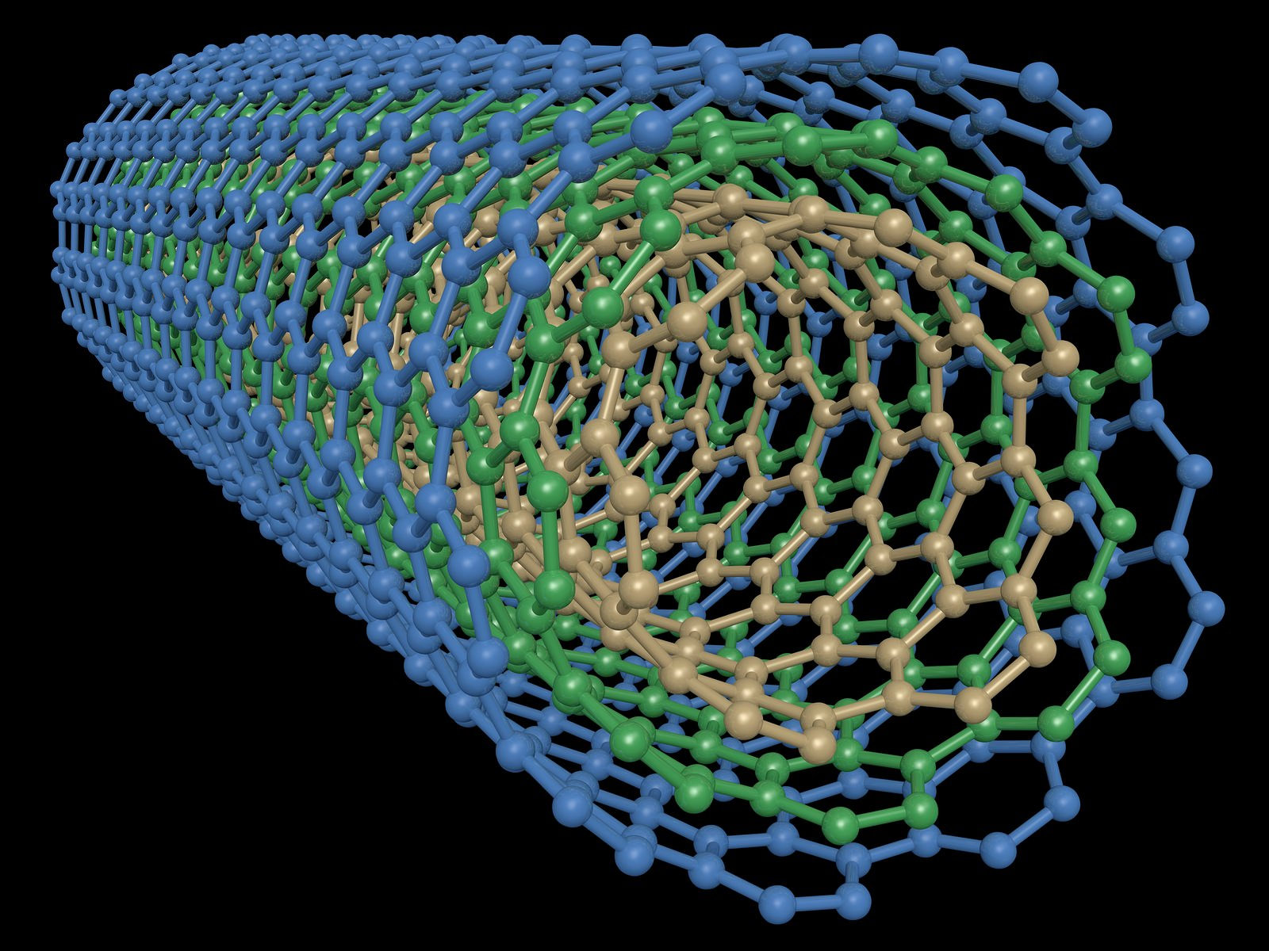

2015 – 2040
GLOBAL MULTIWALLED CARBON NANOTUBES MARKET OVERVIEW
Prepared for :
MARKET INTELLIGENCE . CONSULTING
www.techsciresearch.com

Slide 2
Market Overview: Global Multiwalled Carbon Nanotubes Market
Global Multiwalled Carbon Nanotubes Production, By Volume, 2015, 2020, 2021E and 2040F (Tonnes)
Global Multiwalled Carbon Nanotubes Capacity, By Volume, 2020 (Tonnes)
The demand of the Multiwalled Carbon Nanotubes currently stands at 2800 tonnes approximately. The demand in the forecast years is anticipated to increase at a CAGR of 2.91% and reach 5428 tonnes by 2040. The demand of the Multiwalled Carbon Nanotubes is anticipated to grow due to boosting demand in Electronic and Electrical Industry for semiconductors and in Plastics and Composites Industry to enhance electrical and mechanical properties of the products. Usually, there are two types of purposes of MWCNT< research and Industrial. The demand of Industrial grade MWCNT will rise in the forecast years.
On the global level, the top operating players in the Multiwalled Carbon Nanotubes market is Chengdu Organic Chemistry Co., CNano Technology Limited, LG Chem, Nanocyl S.A., Showa Denko K.K. and Arkema Inc. These top five operating players have a manufacturing capacity of more than 400 tonnes and usually serve the industrial applications. There are a huge number of manufacturing facilities that have the capability to manufacture MWCNT for research purposes in small quantities.
Global Multiwalled Carbon Nanotubes Market Share, By End User Industry, By Value, 2021E
Global Multiwalled Carbon Nanotubes Market Share, By Manufacturing Process, By Volume, 2021E
The global market of the Multiwalled Carbon Nanotubes will be dominated by Plastics and Composite Industry followed by Electrical and Electronics Industry with a market share of 54.12% and 27.76% in 2021. Based on the properties required in the end product, the concentration of MWCNT is varied. For example, 1% wt. addition of Multiwalled Carbon Nanotubes in products is done to improve the mechanical properties and 3% wt. addition of Multiwalled Carbon Nanotubes is required to improve the electrical properties.
Catalytic Chemical Vapor Deposition (CCVD) is the most popular manufacturing process of Multiwalled Carbon Nanotubes followed by Chemical Vapor Deposition (CVD). These two processes are similar with small variation in the manufacturing process. CCVD requires catalyst that helps in reducing the temperature of the manufacturing process and provides higher selectivity of the product. CCVD is also simpler than CVD and thus is preferred mode of manufacturing globally.

Slide 3

Recommendations for HPCL
It is recommended that HPCL should involved in manufacturing of Multiwalled Carbon Nanotubes due to rising domestic and international demand. HPCL is recommended to focus on manufacturing large quantities of MWCNT for industrial applications.
The return of investment is expected to be relatively higher for the forecasted due to rising demand. HPCL is advised to invest in Research and Development of Multiwalled Carbon Nanotubes and produce inimitable nanostructures that can be used by the customers.
The factors that are expected to impact the demand of Multiwalled Carbon Nanotubes are increasing number of competitors in the market. Multiwalled Carbon nanotubes is relatively cheaper and widely used than Single Walled Carbon Nanotubes. Thus, the competitiveness is increasing.
The Cost Competitiveness is also expected to increase in the market due to increasing with the rising focus of the industry players on providing research and development of the product to provide effective and unique solutions for different applications.

Slide 4

TechSci Research – North America
708 Third Avenue, Manhattan,
New York, United States
Tel: +1- 646- 360- 1656
Email: sales@techsciresearch.com www.techsciresearch.com
Thank you!!
We look forward to serving your research needs!!
TechSci Research – Europe
54, Oldbrook, Bretton,
Peterborough,
United Kingdom
Email: sales@techsciresearch.com www.techsciresearch.com
TechSci Research – Asia-Pacific
B – 44, Sector – 57, Noida, National Capital Region, U.P. - India
Tel: +91-120-4523900
Email: sales@techsciresearch.com www.techsciresearch.com

